Slide 1
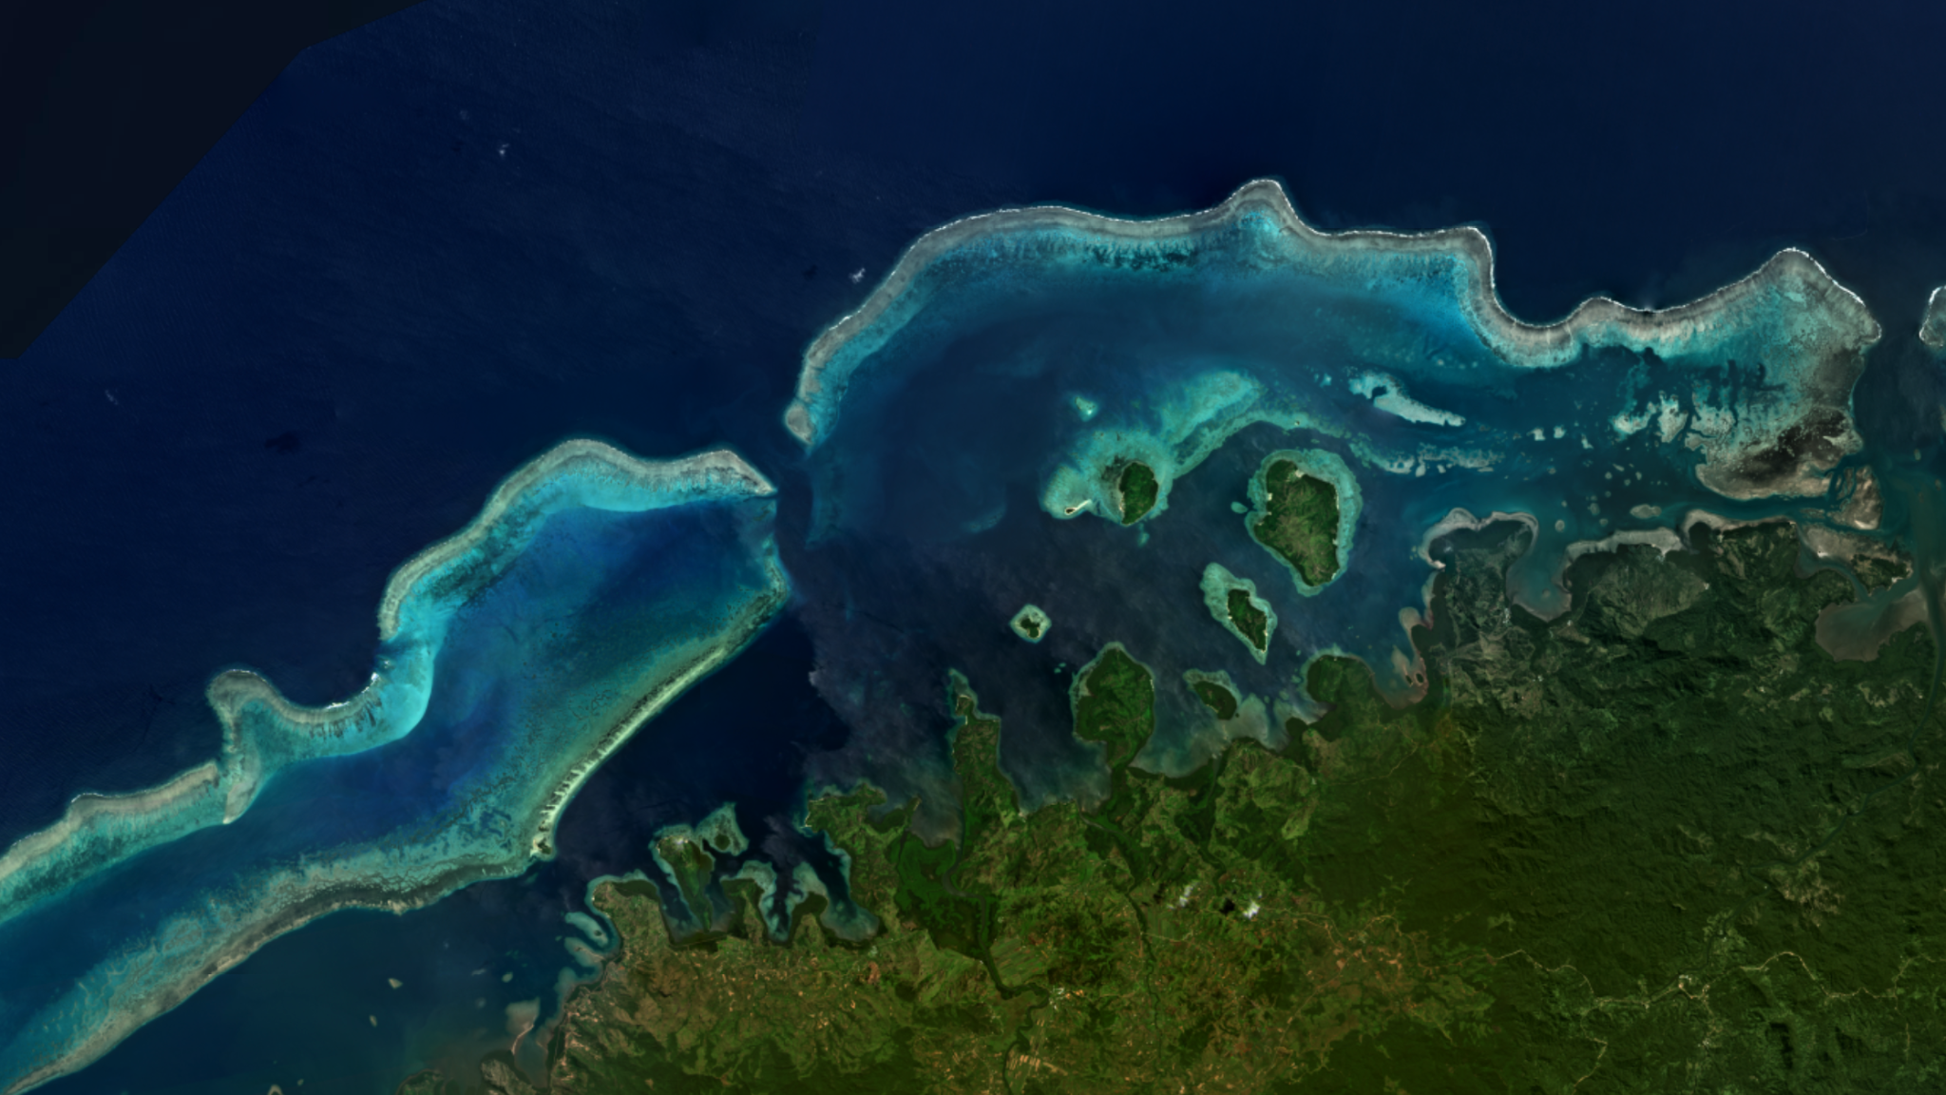
Allen Coral Atlas
Mapping and monitoring the world’s coral reefs
(from space)

Slide 2
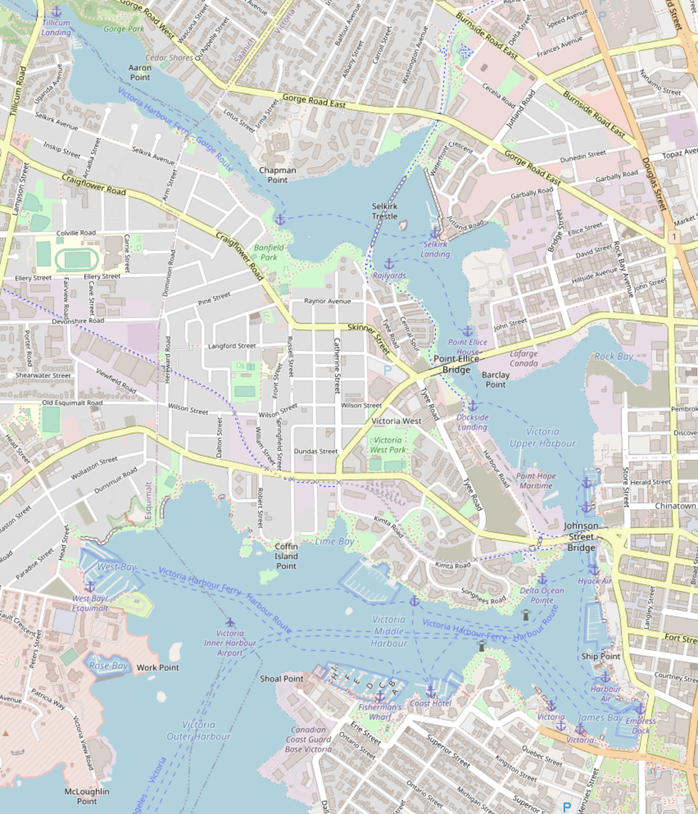
Territorial acknowledgement
I live and work on the traditional territory of the Songhees & Esquimalt First Nations, and surrounded by their fishing grounds.
We meet here on the traditional territory of the Duwamish and Suqamish Tribes, also surrounded by their fishing grounds.
The Allen Coral Atlas surveys the fishing grounds of hundreds—if not thousands—of distinct cultures, all with their own deep relationships with the reefs we map.
Notes:
Stress the ongoing relationship to the waters in all 3 cases.

Slide 3
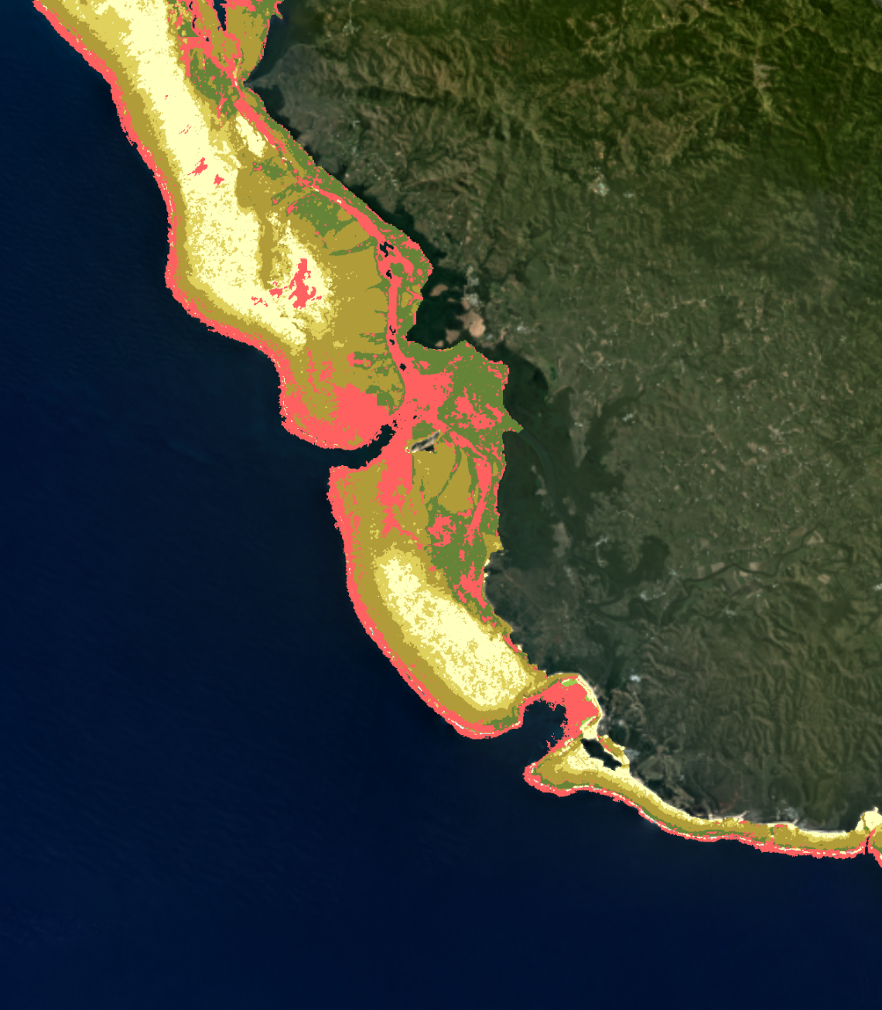
Overview
Why coral?
Why space?
The partnership and process
Data validation
Weird PostGIS tricks
Who uses it

Slide 4
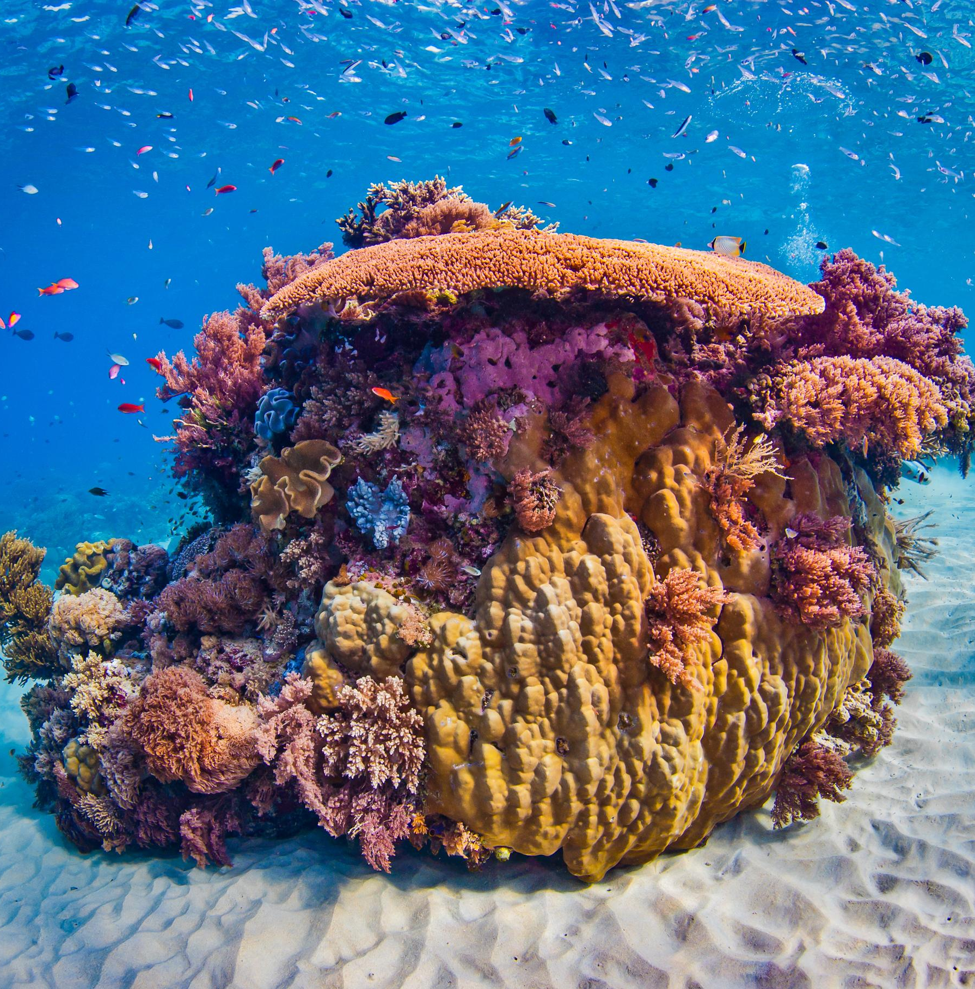
Why coral?
It’s beautiful!
25% of all oceanic fish depend on it directly
Provides storm protection
It’s fragile
Look at it, it’s beautiful.

Slide 5
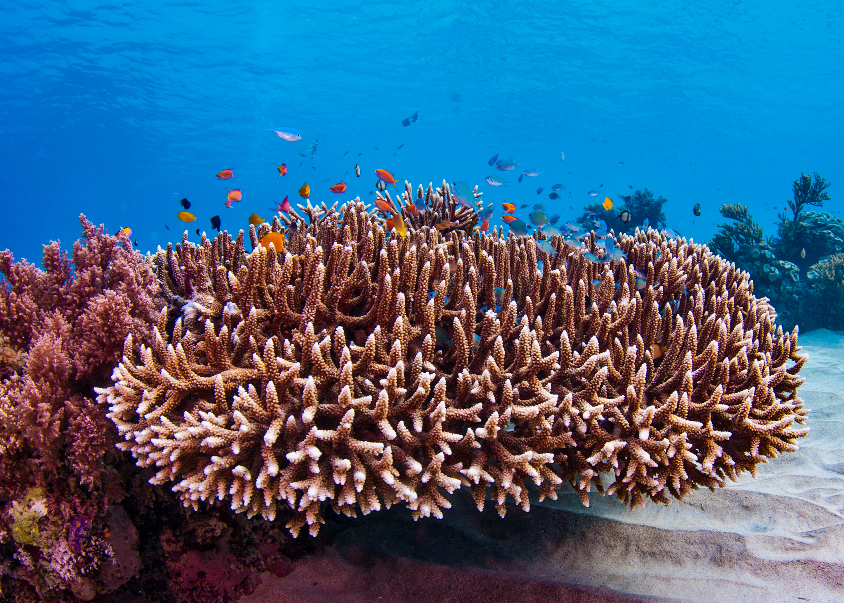
Threats to coral
Heat
Acidification
Physical disturbance
Runoff
Predation

Slide 6
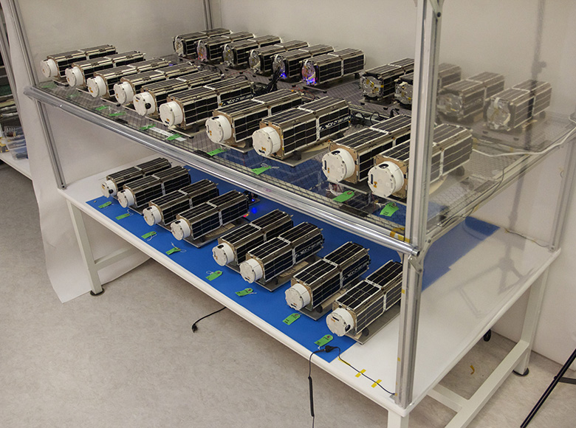
Why space?
Whole planet photographed daily
Newly cheap
Allows a standard global map
Lets us watch changes

Slide 7
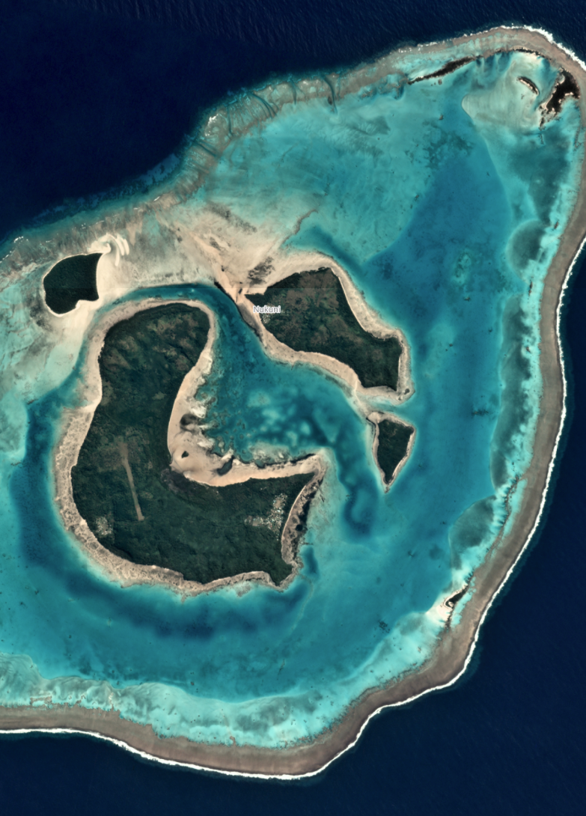
Our Global Partnership
Arizona State University: Leading the partnership, ASU’s role includes strategy and management, coral reef monitoring, software engineering, communications, and engagement & outreach.
Planet: Planet satellites provide the backbone of many of our data products.
University of Queensland: The UQ team maps reef habitats and works alongside local teams to verify the maps.
Coral Reef Alliance: The CORAL team leads validation and outreach related to the monitoring system.
Vulcan Inc: As an original founding partner, Vulcan supports strategy development for policy use cases.
Notes:
Also talk about my own role here

Slide 8
Reef Mapping

Slide 9
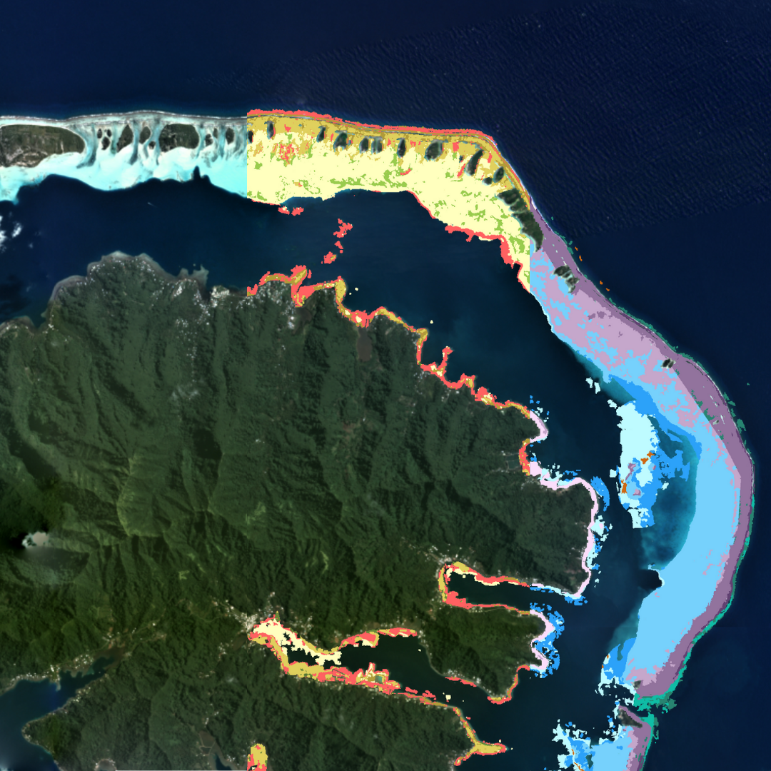
The products
Habitat maps

Slide 10
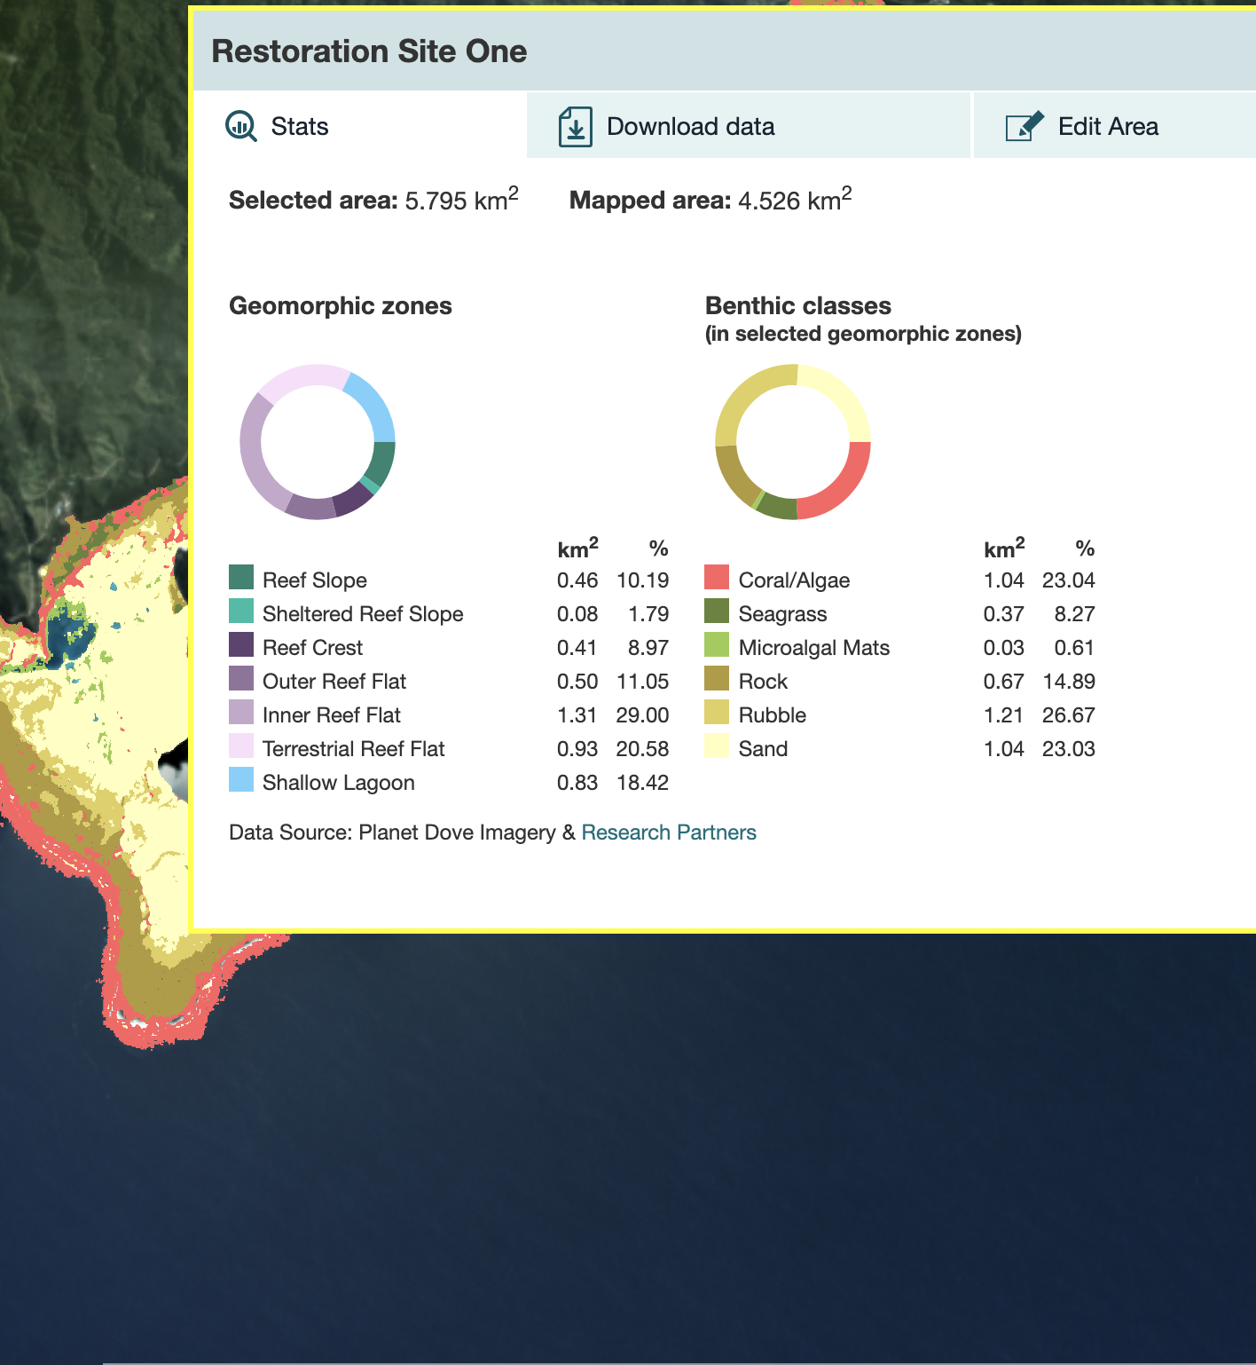
The products
Habitat maps
Statistics

Slide 11
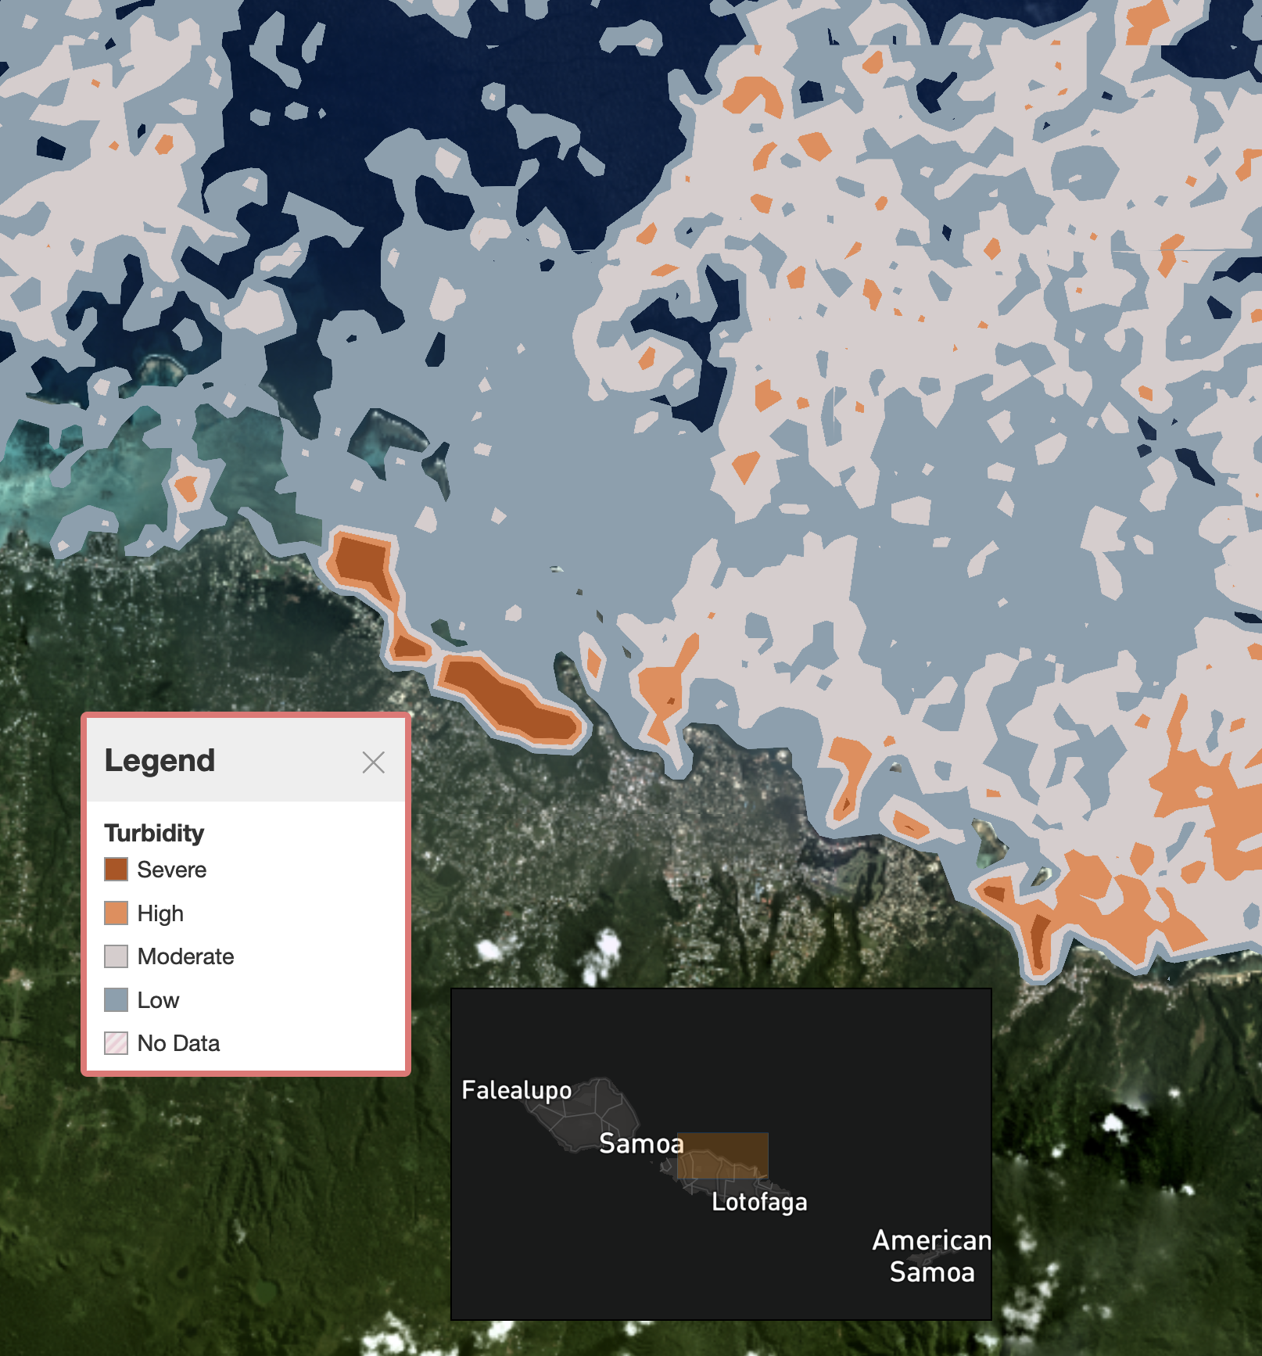
The products
Habitat maps
Statistics
Turbidity

Slide 12
The products
Habitat maps
Statistics
Turbidity
Downloads

Slide 13
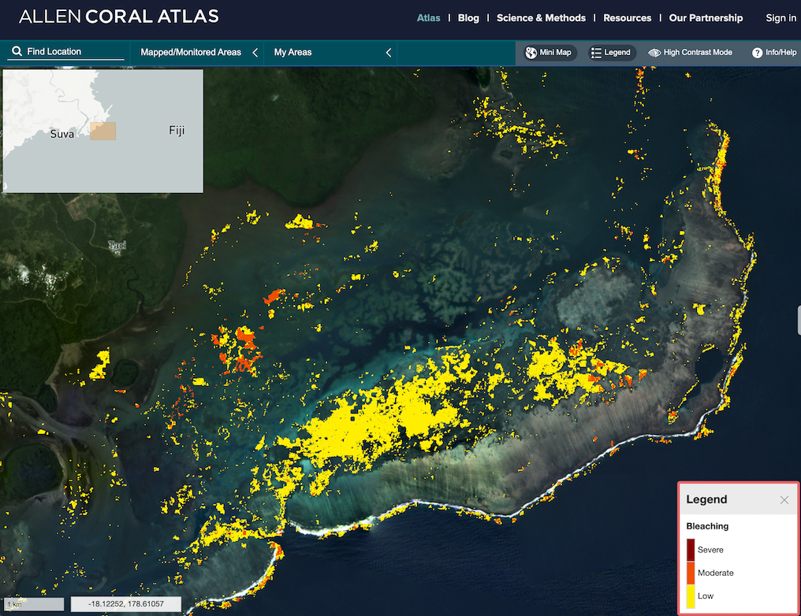
The products
Habitat maps
Statistics
Turbidity
Downloads
Monitoring

Slide 14
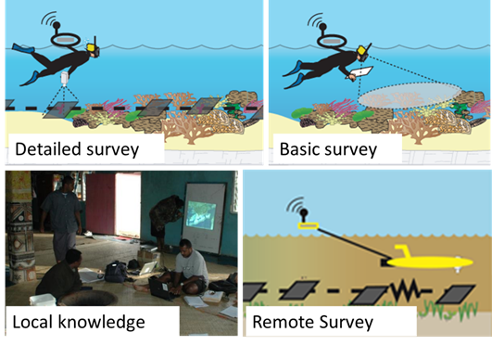
Validation

Slide 15
Weird PostGIS tricks
PostGIS is magic. I’m not just saying this for Paul.
Spatial indexes especially!
But sometimes our data were just the right shape to make queries slow until I learned the incantations.
Notes:
This is a very audience-specific interlude; I’ll be speaking right after one of the main PostGIS devs.

Slide 16
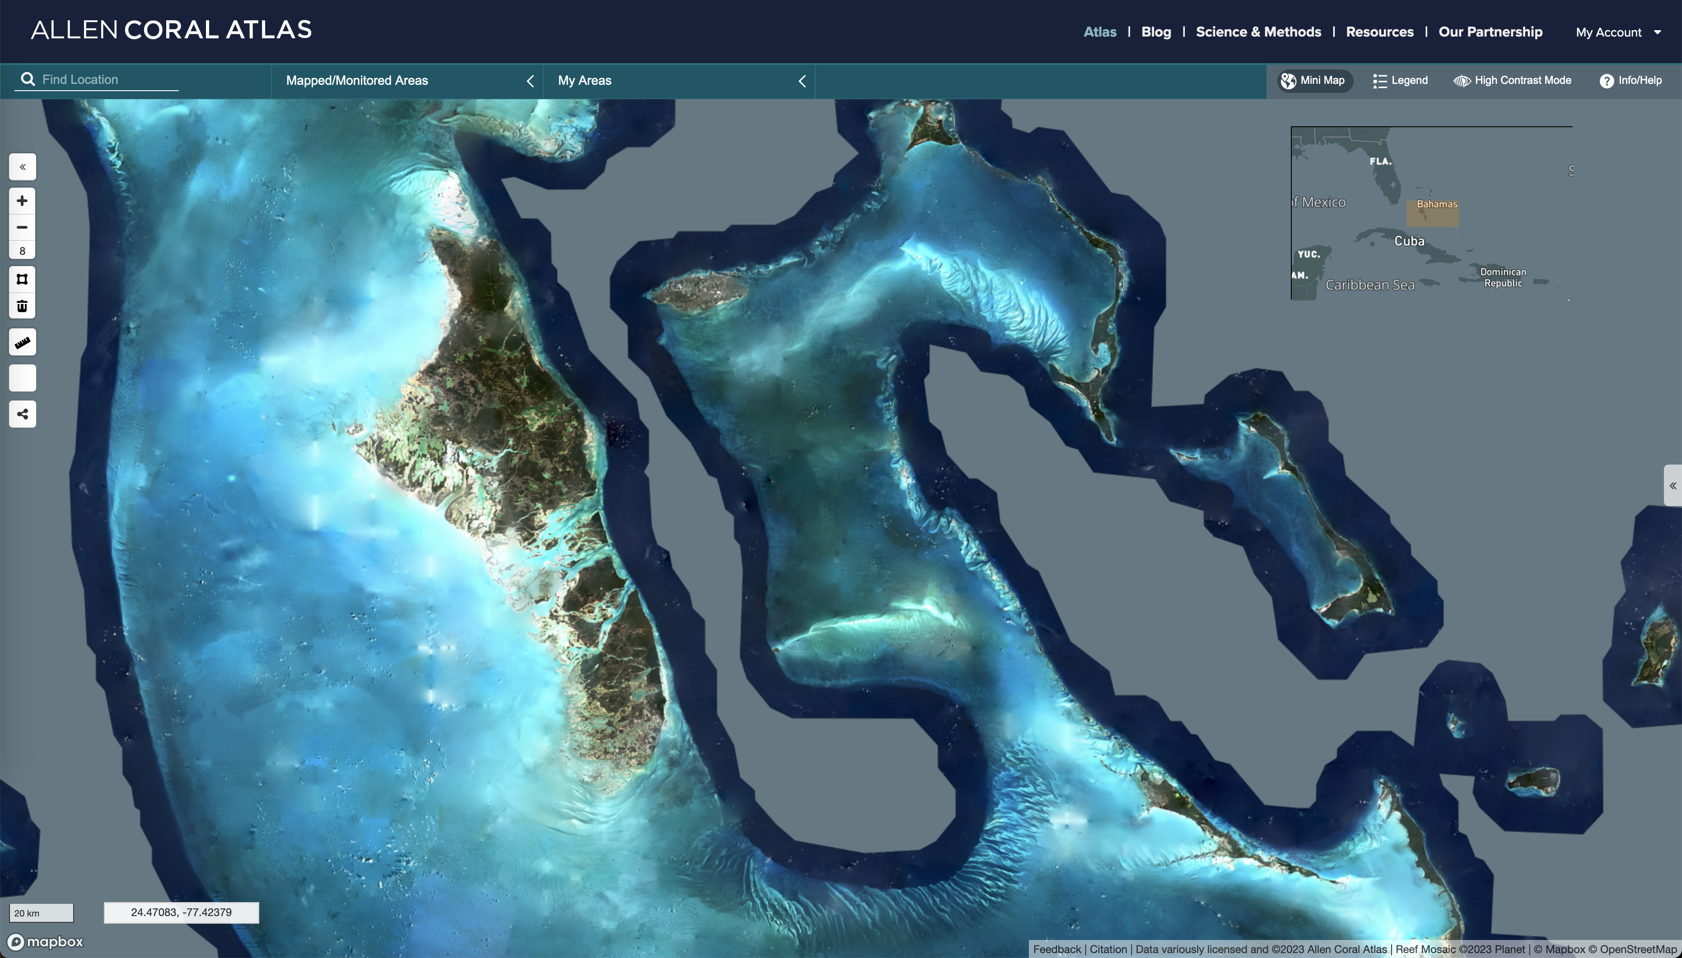
Example: The Bahamas
Notes:
This is our largest area of shallow water

Slide 17
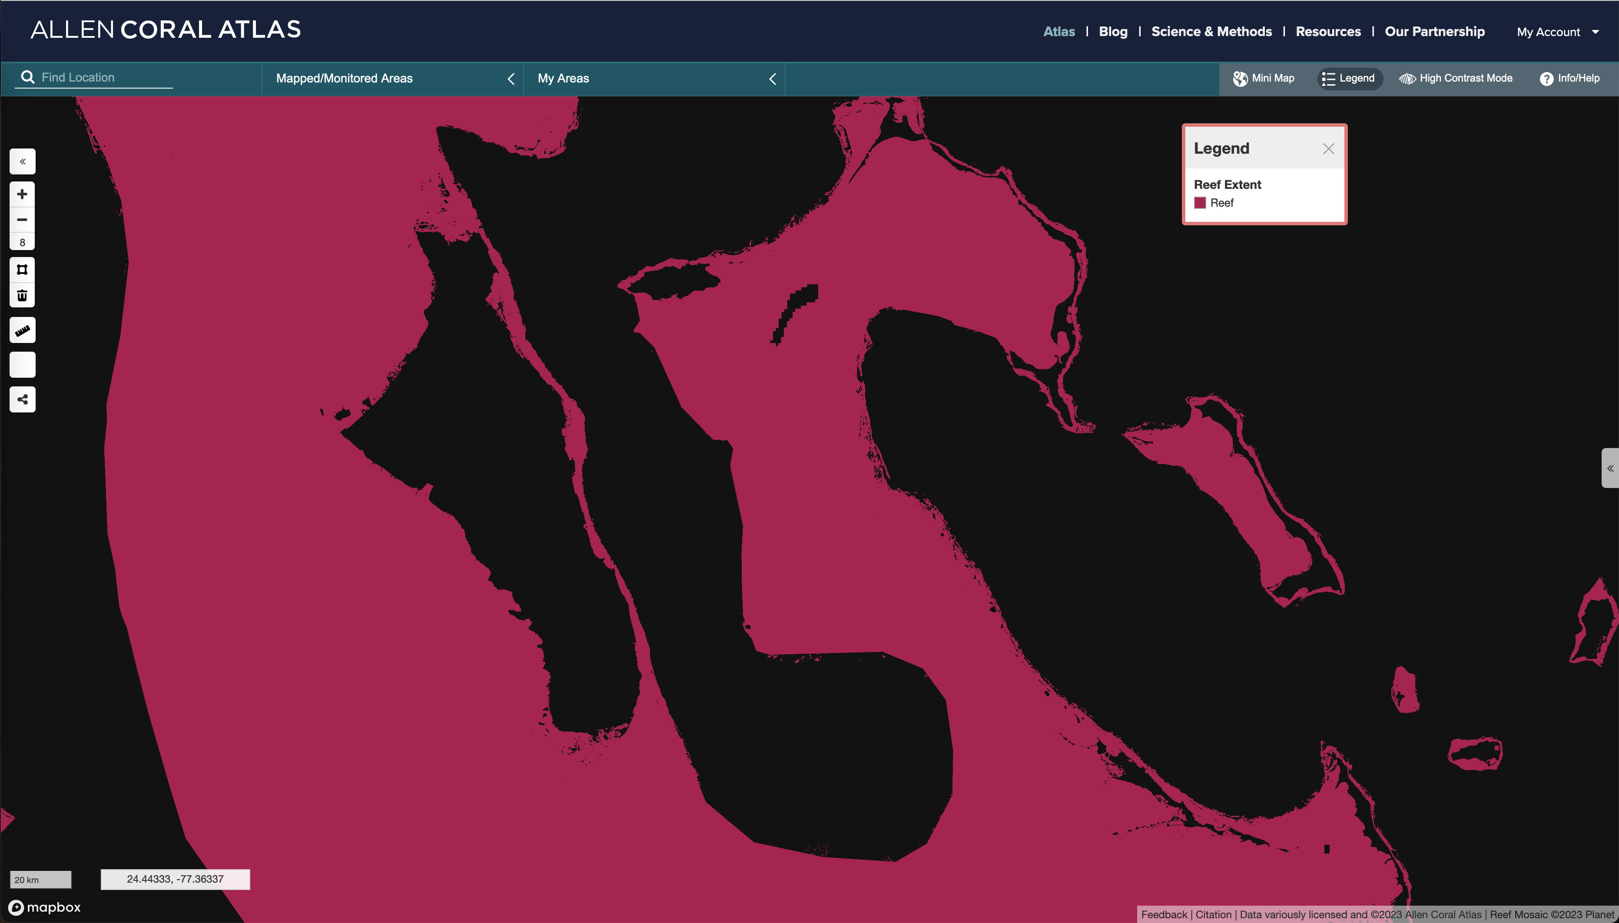
Example: The Bahamas reef extent
Notes:
Simple enough in the reef extent layer

Slide 18
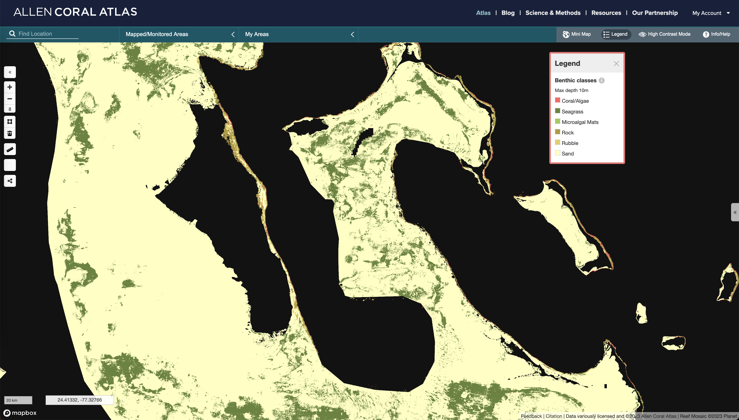
Example: The Bahamas seagrass
Notes:
But look at the complexity of the seagrass shapes, and the extent of the sand area.

Slide 19
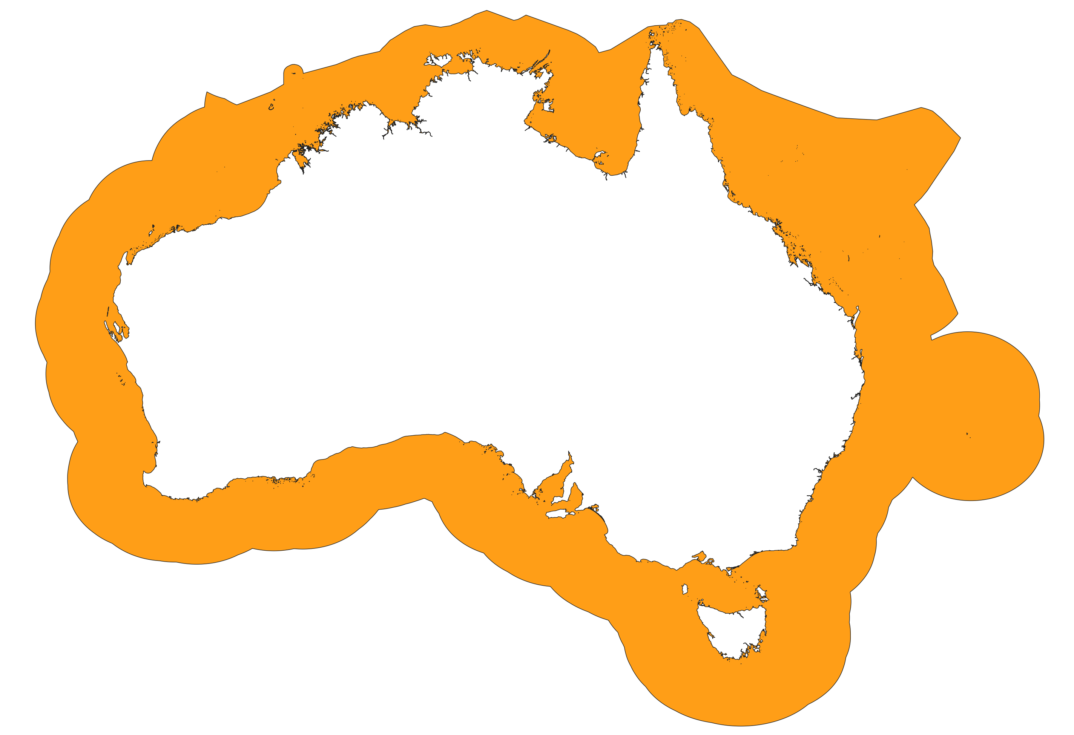
Example: Australia
Notes:
Hidden complexity of the coastline

Slide 20
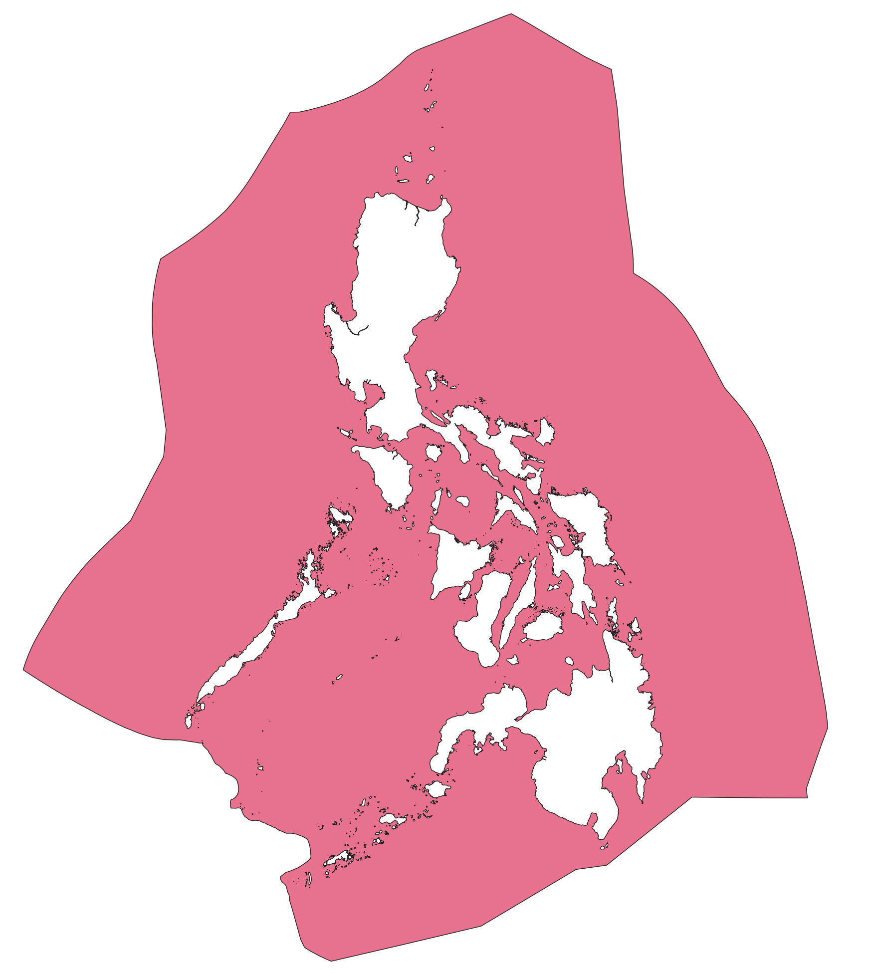
Example: Philippines
Notes:
Look at all those islands!

Slide 21
Summarising the tricks
Caching what we can
Avoiding ST_Intersection() where possible
Making friends with ST_Subdivide()
Iterating over MultiPolygons

Slide 22
What it’s used for
New protected areas
Management plans
Research
Restoration planning

Slide 23
Stay in Touch
Allen Coral Atlas:
@AllenCoralAtlas on social media
Emails:
Support@AllenCoralAtlas.org
Feedback@AllenCoralAtlas.org
Visit us! AllenCoralAtlas.org
Scan the QR Code for links to everything →
Me:
https://eldang.xyz/
eg@eldang.xyz
Notes:
Thank you for listening, please use the QR code for links to the resources mentioned and to stay in touch!

