Slide 1
Dynamic EV Charging Infrastructure Prioritization
CUGOS Fall Fling, 10/6/2019
Corwin Bell, Fehr & Peers
Notes:
Acknowledgment: “This material is based upon work supported by the U.S. Department of Energy’s Office of Energy Efficiency and Renewable Energy (EERE) under the Vehicles Technologies Office (VTO) Deployment Award Number DE-EE0008261.”
Disclaimer: “This report was prepared as an account of work sponsored by an agency of the United States Government. Neither the United States Government nor any agency thereof, nor any of their employees, makes any warranty, express or implied, or assumes any legal liability or responsibility for the accuracy, completeness, or usefulness of any information, apparatus, product, or process disclosed, or represents that its use would not infringe privately owned rights. Reference herein to any specific commercial product, process, or service by trade name, trademark, manufacturer, or otherwise does not necessarily constitute or imply its endorsement, recommendation, or favoring by the United States Government or any agency thereof. The views and opinions of authors expressed herein do not necessarily state or reflect those of the United States Government or any agency thereof.”

Slide 2
Outline
Introduction
Background and Purpose of the Project
EVSE Dynamic Siting Tool
Shared Mobility Hub Prioritization
Implementation Plan
Limitations
Notes:
Cover context briefly, save details for Q&A.
Focus on data sources.
Go through weights quickly.
Focus on Tool Results and Web-app.
Very brief on siting considerations.
Key Takeaway: Growing supply of open spatial data with nationwide coverage

Slide 3
Introduction
Project Overview
Accelerate EV adoption in shared mobility
Establish best practices for other US cities
Partners
Notes:
The Seattle Department of Transportation (SDOT), in close collaboration with other City and external partners, developed this Electric Vehicle Supply Equipment (EVSE) Roadmap for Shared Mobility Hubs (“EVSE Roadmap”) to provide improved connections to public transit via electrically-powered shared mobility services such as car share and ride-hail services. This EVSE Roadmap outlines an initial regional strategy for Seattle to test an innovative method to increase EV adoption in shared mobility services. SDOT is acting as project manager, but is not the owner of any infrastructure installed as a result of this project.
A full report of the EVSE Roadmap is published on SDOT’s website.
Only Mention if asked: MULTI-REGIONAL GRANT OVERVIEW
Four U.S. cities have joined together to demonstrate the potential for electric shared mobility services. With funding from the U.S. Department of Energy and a team of valuable partners, “Making the Business Case for Smart, Shared, and Sustainable Mobility Services” aims to accelerate the adoption of electric vehicles in shared mobility applications and to establish best practices that can be used by others around the United States. The project, led by the City of Seattle and Atlas Public Policy, brings together the U.S. Department of Energy’s Energy Efficient Mobility Systems program and major industry stakeholders with the cities of Seattle, New York, Portland, and Denver to test different electric, shared mobility interventions.
In the Seattle region, the Seattle Department of Transportation is partnering with Seattle City Light, Office of Sustainability & Environment, ReachNow, Eluminocity, and other shared mobility service providers to significantly increase the supply of publicly available DC fast charging stations throughout the City with a specific focus on integration with 20 of the City’s shared mobility hubs, and monitoring the impact of a more robust charging network on shared mobility operations. SDOT, as the lead grant recipient and in alignment with its role managing the City’s transportation systems, manages the project’s overall implementation and coordination amongst project partners.

Slide 4
Sources of U.S. Carbon Emissions
Notes:
As of 2017, Transportation was the largest source of GHG emissions in the US at 29%, and the predominant source of criteria air pollutants in many air basins.
Source: https://www.epa.gov/ghgemissions/inventory-us-greenhouse-gas-emissions-and-sinks

Slide 5
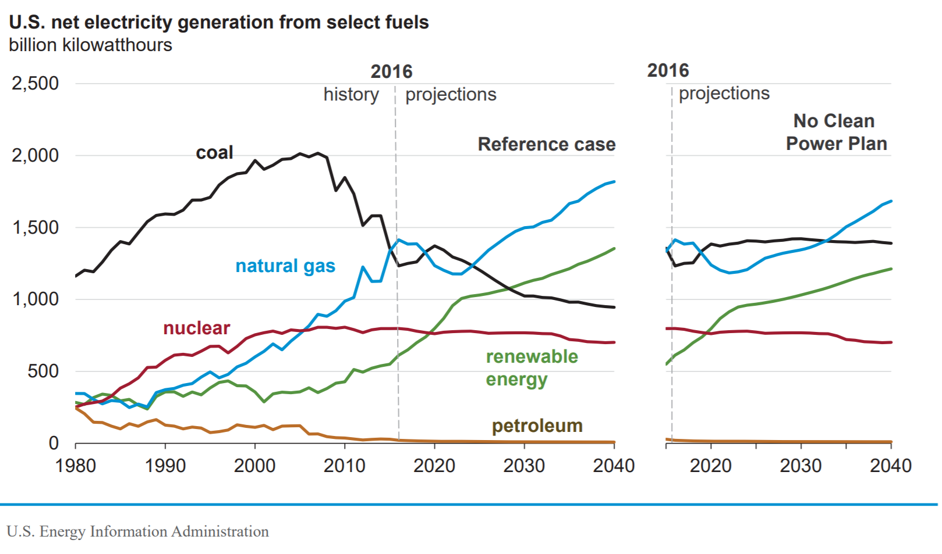
Electricity is Getting Cleaner
Notes:
Since the data for the previous chart was released, electricity generation has gotten cleaner and the trend is promising. Thus accelerating the conversion of internal combustion engine (ICE) vehicle miles travelled (VMT) to increasingly cleaner electric VMT has the potential to address local air quality and global climate change goals.

Slide 6
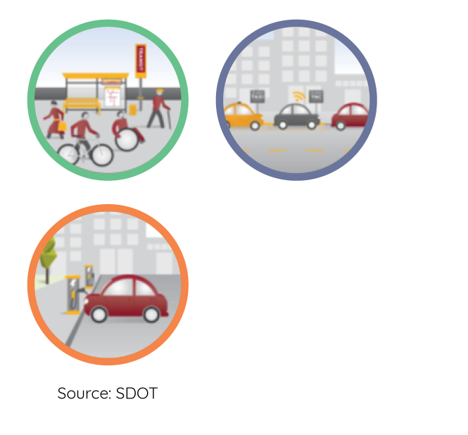
Shared Mobility Hubs
What are they?
Major transit connections with complementary shared travel modes and services
Why should they be electrified?
Reduce emissions by accelerating EV adoption for high mileage modes
Notes:
WHAT IS A SHARED MOBILITY HUB?
A Shared Mobility Hub is a place where transportation connections, travel information, and community amenities are aggregated into a comfortable, seamless, understandable, and on-demand travel experience. Shared Mobility Hubs are generally located with major transit facilities and at places where frequent services intersect to allow easy transfers between mobility services. In addition to transit, Shared Mobility Hubs may include legible connections to car share, bike share, bike parking, ride-hail pick-up and drop-off, kiss-and-ride, and freight delivery, as well as connections to local bike and pedestrian routes. They may also include placemaking and placekeeping programming to help them function as vibrant community spaces rather than just “through” spaces. The planning and design of Shared Mobility Hubs will use a hierarchical approach to designate curb space use near the hub area. That hierarchy will maximize access to the Shared Mobility Hub using a people-first approach. SDOT has identified over 100 recommended Shared Mobility Hub locations which were used for this analysis. These locations are subject to change based on future analysis and development.
WHY SHOULD THEY BE ELECTRIFIED?
Shared Mobility Hubs are central to SDOT’s strategy to shape shared mobility options so that they serve the City’s climate, transportation equity, and demand management goals. The Shared Mobility Hub program leverages shared mobility to enhance transit access and ridership, reducing harmful emissions and transportation costs for the people of Seattle. Without the Shared Mobility Hub Program, shared mobility providers could build services to supplant transit, increasing harmful emissions and transportation costs. By electrifying shared mobility options with charging infrastructure as a part of the Shared Mobility Hub implementation plan, SDOT can further reduce emissions by accelerating adoption of electric vehicles among shared mobility providers.

Slide 7
Barriers to EV Adoption
High Vehicle Cost
Lack of Awareness
Lack of Reliable Public Charging
Notes:
1.1 Barriers to Increasing Adoption of EVs in Shared Mobility Services
Current barriers to the electrification of shared mobility services include high vehicle costs, a lack of awareness around EVs, limited access to home charging, and a lack of reliable public charging which causes drivers “range anxiety.” The lack of a consistent network of easily accessible and public EVSE limits the ability for ride-hailing services and car share providers to substantially increase their EV fleets. The core objectives of the EVSE Roadmap were developed to address these key concerns.
Cities have citywide private ownership based incentives through zoning code requirements for a percentage of off-street parking spaces to have EV chargers, but these may not be publicly available, and if they are, they are often out of sight and out of mind.

Slide 8
Primary Objectives
EV Network Development
Fill gaps in existing EV charger network
Equity & Environmental Justice
Address air quality and environmental justice objectives
Shared Mobility
Serve locations with current high market demand for ride-hailing and carsharing services
Gaps in Transit Access
Enable better first-last mile connections to high-capacity transit
Notes:
The goal of SDOT’s EVSE program is to prioritize EVSE where ride-hail and car share vehicle demand is high, a gap in the EVSE network exists, and deployment of EVSE could be both equitable and result in a positive impact on a community.
EV Network Development – identifies Shared Mobility Hubs that are in locations with a less established network of EV chargers, particularly DC fast chargers, and which support EV charging behavior based on user feedback • Remove barriers to EV adoption, and increase the potential of EV adoption/use in ride-hail and car share services
Equity & Environmental Justice – identifies Shared Mobility Hubs that can address air quality and environmental justice objectives by identifying areas of historical underinvestment and that face inequitable environmental burden from air and noise pollution • Incorporate community input when deploying EV charging sites to avoid exacerbating displacement of people of color and low-income households • Improve public health by reducing emissions, improving air quality and addressing climate change
Shared Mobility – identifies Shared Mobility Hubs to serve locations with current high market demand for ride-hailing and carsharing services and potential future market demand
Gaps in Transit Access – identifies Shared Mobility Hubs with relatively poor connecting transit service and low vehicle ownership to enable better first-last mile connections to high-capacity transit • Improve safe and accessible connections to transit, which provides access to services, employment, and education
We recognize that historically disinvested communities are correlated with those both currently experiencing displacement and at risk of experiencing future displacement. To avoid exacerbating ongoing displacement, potential sites in areas with high displacement risk will be identified so project partners can be cognizant of this sensitivity and work to mitigate displacement risk in their efforts as feasible. SDOT’s suggested research-based approach to mitigating displacement risk will be outlined in its EVSE Equity Toolkit (currently in development).
DC FAST CHARGERS VS LEVEL 2 CHARGERS
Early in the process of developing the EVSE Roadmap Strategy, the project team determined that DC fast chargers should be prioritized over Level 2 (L2) chargers. This decision was largely based on the expected use of charging infrastructure by ride-hail and car share providers and only refers to EVSE prioritization within the context of this project. Their operational models (both for drivers and fleet support technicians) benefit from a network of DC fast chargers to enable quick turnover of vehicles and to ensure the vehicles are in service for a majority of the time.
While L2 chargers do have a potential use case for ride-hail drivers at their place of residence, the priority focus was on DC fast chargers to address the major gaps in the DC fast charger network and fulfill Seattle’s intervention strategy for the project to electrify Shared Mobility Hubs. Additionally, as vehicles with greater range continue to enter the EV marketplace, the long-term demand may shift toward DC fast chargers to enable quick charging to complete a day’s activities, and to allow multiple vehicles to use one charger per day. Prioritizing DC fast chargers establishes a network of locations that are more adaptable to future EVSE technology and user expectations for charging infrastructure.

Slide 9
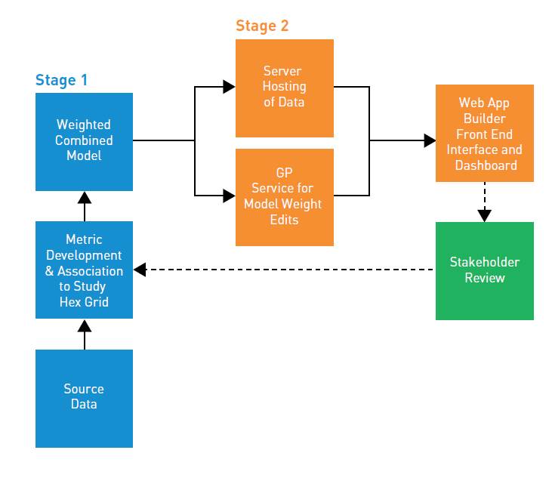
EVSE Dynamic Siting Tool
Notes:
Stage 1: Represents a process of data collection, data processing, metric development, and initial model criteria weighting based on initial research and feedback.
Stage 2: Represents a deployment of back-end and front-end technologies to host analysis results, background data, and geo-processing services to provide an interactive dashboard for decision makers.

Slide 10
Data Sources
Metric | Input Layer/Table Name | Output Scored Field Name | Data Source
EV Network Development
Existing EV Charging Locations | Existing_EV_Chargers.csv | EVCHRG_SCR | US Department of Energy Alternative Fuels Data Center
Accessibility to Major Highways | gis_osm_roads_free_1.shp | RETD_SCR | Open Streets Map (OSM)
Retail Amenities | gis_osm_pois_free_1.shp | HWYAC_SCR | OSM
Equity & Environmental Justice
Low-income Households | EJ_Screen_Primary (feature class), Field: LOWINCPCT | LOWINC_SCR | US Census American Community Survey (Census)
Minority Households | EJ_Screen_Primary (feature class), Field: MINORPCT | MINOR_SCR | Census
Traffic Pollution Index | EJ_Screen_Primary (feature class), Field: PTRAF | PTRAFF_SCR | US Environmental Protection Agency Environmental Justice Screen (EJ SCREEN)
Shared Mobility
Parking Turnover Index | PublicGaragesLots.shp, SeattleStreetSigns.shp | PRKTUR_SCR | Seattle Department of Transportation (SDOT)
TNC Demand | TNC_Data_2018_Q1.xlsx | TNCTE_SCR | SDOT
Carshare Demand | ReachNow_Q1_2018_aggregate.csv | CARSH_SCR | SDOT
Gaps in Transit Access
Low-frequency Transit Access | HighFreqRoutesatStops10min (feature class) | TRANAC_SCR | King County Metro General Transit Feed Specification (GTFS)
Zero Vehicle Households | ACS: X25_HOUSING_CHARACTERISTICS (file geodatabase table) | ZVEH_SCR | Census
Notes:
Publicly available and regionally or nationally-based data sources were prioritized for inclusion in the tool to ensure the tool could continuously be updated and to allow for potential expansion to other cities and regions in future efforts. Identifying appropriate data sources was the first step in an iterative tool development process that incorporated a number of checkpoints with stakeholder review.

Slide 11
EV Network Development
Notes:
Existing EV Charger Locations: Provides information about existing chargers to prioritize gaps in the EV charging network and is the key metric driving the prioritization (ensuring coverage of the city).
Accessibility to Major Highways: Key element identified from ride-hail drivers to prioritize easy-to-access charging locations, but had strong correlation with Parking Turnover Index/Ride-hail Demand/Car share Demand metrics.
Retail Amenities: Key element identified from ride-hail drivers to prioritize areas with amenities that can be used while they wait for vehicles to charge. Lower weighting because of correlation with Parking Turnover Index.

Slide 12
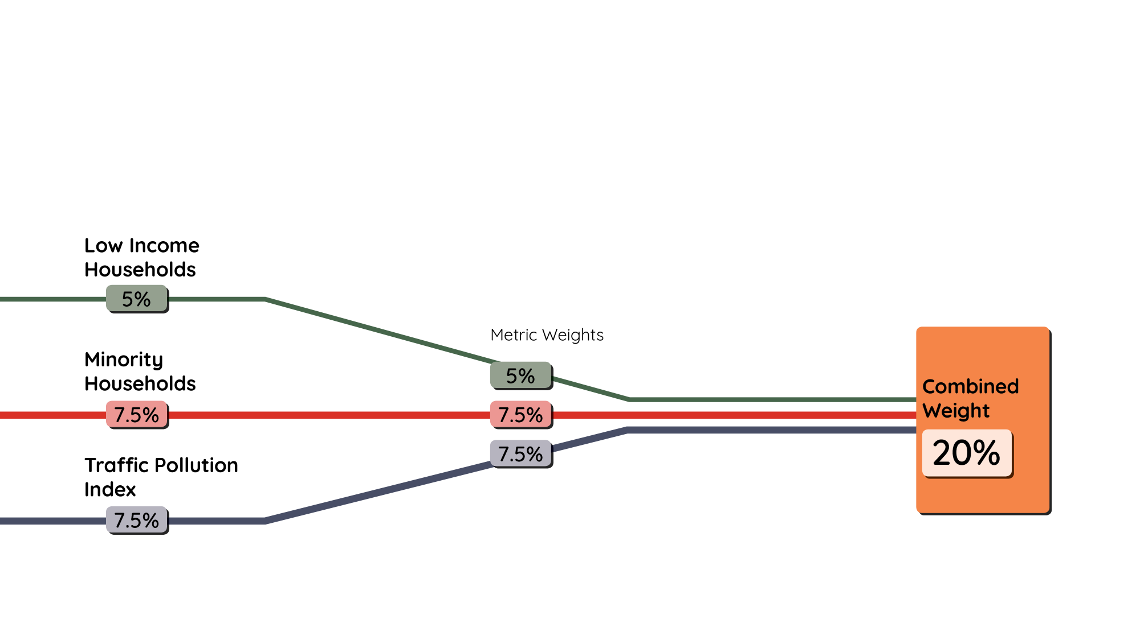
Equity & Environmental Justice
Notes:
Low-income Households: This metric is a proxy for communities that have historically experienced disinvestment. Strong correlation with Minority Household metric
Minority Households: This metric is a proxy for communities that have historically experienced disinvestment. Strong correlation with low-income household metric, however Seattle’s Environmental Justice principles place higher focus on race over income.
Traffic Pollution Index: This metric uses high Vehicle Miles Traveled (VMT) locations as a proxy for areas bearing inequitable environmental burdens that can be partially addressed by higher EV adoption.

Slide 13
Shared Mobility Demand
Notes:
Parking Turnover Index: On-street parking regulation and off-street parking pricing serve as proxies for higher vehicle turnover, thus implying opportunities for current and future shared mobility demand. Directly correlated with Car share Demand, Ride-hail Demand and Retail Amenities metrics.
Ride-hail Demand: Primary demand metric for shared mobility, however directly correlated with Car share Demand and Parking Turnover Index.
Car share Demand: Primary demand metric for shared mobility, however directly correlated with Ride-hail demand and Parking Turnover Index.
These metrics all turned out to be highly correlated so their weights were reduced to minimize double counting.

Slide 14
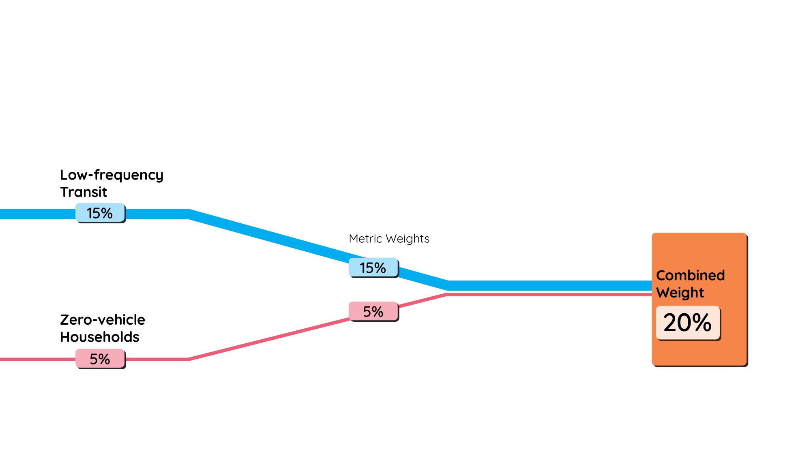
Gap in Transit Access
Notes:
Low-frequency Transit Access: Proxy for increased need for a vehicle to provide first-last mile access to high-capacity transit, including ride-hail/car share.
Zero Vehicle Households: Proxy for higher propensity to benefit from transit access via shared mobility services.

Slide 15
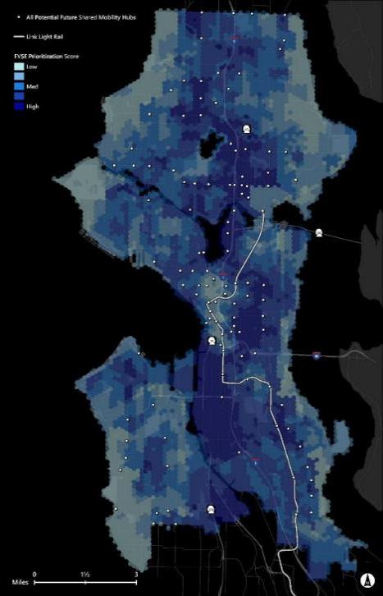
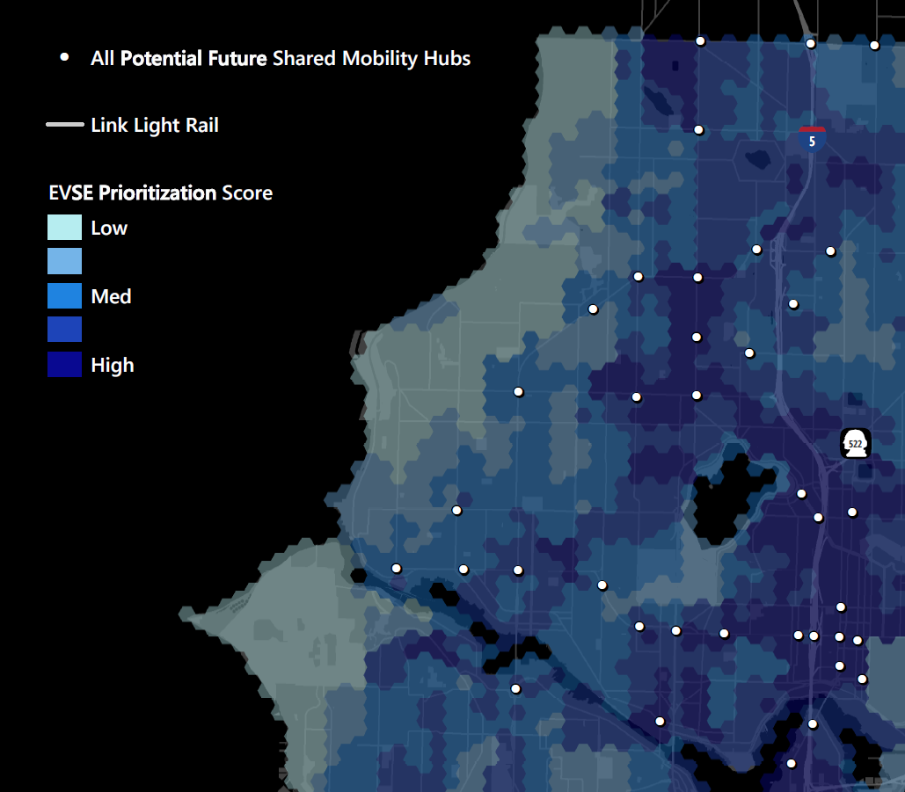
Tool Results
Notes:
To resolve suitable locations for EVSE, a 10-acre hex grid was developed for the City of Seattle. The distance across a 10-acre hex grid is roughly two city blocks. This hex grid is the final study geography that was used to bring together all the inputs for final scoring in the EVSE Dynamic Siting tool.
Weighted Combined Tool
The metrics were combined by using a weighting system to favor important factors in scoring the hex grids. The weighting criteria were developed through literature review, stakeholder feedback, and an iterative process to ensure the tool was representing reasonable results. With 11 metrics, a baseline weighting would apply an approximately nine percent weight to every metric. However, based on the weighting development process, certain metrics warranted a higher or lower weight, both because of the importance of the metric and to account for potential correlation between the metrics.

Slide 16
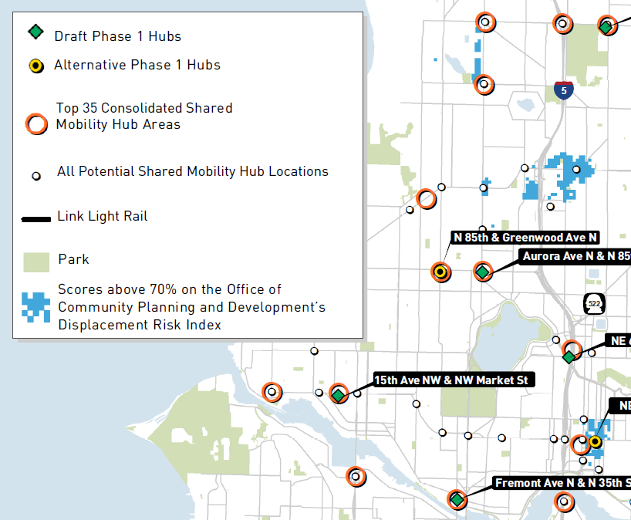
Hub Prioritization
Notes:
Converting the results of the EVSE Dynamic Siting Tool to a prioritization of Shared Mobility Hubs involved considering the hex grids around each hub and adjacent hubs. Specifically, each Shared Mobility Hub was given the average score of the hex grids within a two-block radius (approximately 660 feet). Additionally, given that some Shared Mobility Hubs are within a half-mile of another hub, adjacent hubs were aggregated to provide one representative location for EVSE siting prioritization purposes.
The top 35 locations were then identified and discussed with project partners to develop a list of Shared Mobility Hubs to prioritize for electrification during Phase 1 deployments (October 2018-September 2019) and potential hubs to electrify in Phase 2 deployments (October 2019-September 2020)
Developing the first phase of Shared Mobility Hubs for EVSE deployment involved reviewing the highest ranked Shared Mobility Hub areas and identifying logical locations to ensure expanded coverage and increased density of the EVSE network. Generally, Shared Mobility Hubs scoring in the top 30 percent were considered for electrification and if a location was selected, other locations within one-half mile were deprioritized for Phase 1 deployments. A collaborative multi-week process with city stakeholders and private partners included a detailed review of the top scoring sites to determine potential site priorities and alternatives for specific areas.

Slide 17
Siting Considerations
Partners
Strong collaboration with clearly defined roles
Frequent and open communication
Deliverables and success tracking
Community Engagement
Targeted outreach for shared mobility drivers
Guidance for partners on equity and displacement considerations
Site Feasibility
Three-phase power for DC fast charge
Pole framing configurations
Notes:
Successful implementation of the program relies on strong collaborative partnerships, clearly distinguished roles and responsibilities, frequent and open communication, and methods for tracking deliverables and success throughout the project period.
The first steps for installing public EVSE in all neighborhoods in the city should be meaningful outreach, engagement, and education efforts to convey the benefits of EVs and to identify the primary barriers for EV adoption. The local clean cities coalition, Western Washington Clean Cities (WWCC), will provide targeted outreach and marketing support for this project. SDOT is also developing an EVSE Equity Toolkit to provide guidance to EVSE installers and encourage project partners to implement these strategies as feasible.
After selecting preliminary sites at or near a prioritized Shared Mobility Hub, the site must be evaluated for electrical feasibility, including three-phase power for DC fast chargers. New EVSE may require installation of a new three-phase transformer bank on a ‘free’ electric pole, or there must be an existing three-phase transformer bank of the appropriate voltage for the EVSE nearby to serve the site. There are some pole framing configurations that also prohibit the installation of new transformers within the City of Seattle, including poles located at geographical street corners, primary termination poles, and switch poles. The distance of the electric pole to the EVSE site may impact the costs for installation. For example, with a minimum of approximately $2,000 to $3,000 required to connect to a pole, every additional 50 feet of conduit and wiring necessary to reach a site adds approximately $1,000 to $2,000 to the cost.

Slide 18
Tool Limitations
Some transit modes and planned network and service changes were not included
Important locations at the edge of the city and far from highway access did not score well
Tool does not identify optimal EVSE network layout or planned EVSE installations
Installation cost was not a factor in siting prioritization
Notes:
• The inability to account for other transportation demand factors, such as the Water Taxi, the Ferry System, or potential changes to the transportation network, such as the viaduct removal. The tool does not identify areas of planned EVSE deployment.
• The need identified through stakeholder feedback to site some charging locations at the north and south ends of the city to provide opportunities for ride-hail drivers and car share users entering and leaving the city. Many ride-hail drivers that operate in the City of Seattle do not live in the city itself, but in neighboring regions, or they provide trips across City boundaries; for example, to and from the Seattle-Tacoma International Airport. Areas west of the main I-5/light rail corridor (such as Ballard and West Seattle) do not appear as prioritized because of the limitations of access from the freeway, however ride-hail driver feedback has stated a need to have EVSE in those areas to ensure coverage.
• The tool does not identify an optimal citywide EVSE network layout and therefore it requires an iterative approach to understand how prioritizing one location may deprioritize another location.
• The Displacement Risk layer included to flag areas for further consideration was developed in 2016 and may be out of date in areas across the city. EVSE deployments in areas of high displacement risk should be evaluated on a case-by-case basis to determine best practices for implementation.
• Installation costs were not considered in the tool because costs and complexity for installation can vary significantly between different blocks or even locations on the same block. Rather, the tool focused on identifying high-level prioritization areas, with the understanding that specific costs would be determined by the EVSE provider during actual siting assessment.

Slide 19
Key Takeaways
Cities have an opportunity to align multiple goals with EV charger siting
Existing publicly available data and suitability analysis tools can be applied to virtually any geography in the US
Web-based mapping tools can facilitate dynamic stake holder engagement in decision making

Slide 20
Questions?
Acknowledgment: “This material is based upon work supported by the U.S. Department of Energy’s Office of Energy Efficiency and Renewable Energy (EERE) under the Vehicles Technologies Office (VTO) Deployment Award Number DE-EE0008261.”
Disclaimer: “This report was prepared as an account of work sponsored by an agency of the United States Government. Neither the United States Government nor any agency thereof, nor any of their employees, makes any warranty, express or implied, or assumes any legal liability or responsibility for the accuracy, completeness, or usefulness of any information, apparatus, product, or process disclosed, or represents that its use would not infringe privately owned rights. Reference herein to any specific commercial product, process, or service by trade name, trademark, manufacturer, or otherwise does not necessarily constitute or imply its endorsement, recommendation, or favoring by the United States Government or any agency thereof. The views and opinions of authors expressed herein do not necessarily state or reflect those of the United States Government or any agency thereof.”

