Slide 1
Unoccupied aerial vehicle remote sensing package for student geospatial research
CUGOS Spring Fling
4/21/23

Slide 2
Unoccupied aerial vehicle (UAV, aka drone) photography is a core technique in remote sensing: the precise measurement of environmental data to inform management decisions. However, amid growing industry demand for UAV operators, academic interest in applications of UAV photography, and growing enrollment in remote sensing courses at UW, most students do not have access to UAVs. The UW Geospatial Club, in partnership with the Precision Forestry Cooperative, intends to purchase state-of-the-art drones for use by all in the UW community pending a current Student Technology Fee proposal. We include a heavy-lift enterprise UAV, the DJI Matrice 300, as well as a lightweight, operator-friendly UAV, the DJI Mavic 3E. We also include two specialized cameras for the Matrice 300: the FLIR Vue TZ20-R thermal camera, and the Zenmuse L1 LiDAR/RGB unit. This equipment serves a variety of use-cases, from senior researchers with prior UAV experience to undergraduate students wanting to explore UAV photography. This talk will describe the technical specs of the equipment and highlight use cases for UW practitioners. Logistical considerations for flying drones, including the FAA Part 107 license, restricted airspace, liability insurance, and flight plans will be discussed.

Slide 3
Unoccupied aerial vehicle (UAV, aka drone) photography is a core technique in remote sensing: the precise measurement of environmental data to inform management decisions. However, amid growing industry demand for UAV operators, academic interest in applications of UAV photography, and growing enrollment in remote sensing courses at UW, most students do not have access to UAVs. The UW Geospatial Club, in partnership with the Precision Forestry Cooperative, intends to purchase state-of-the-art drones for use by all in the UW community pending a current Student Technology Fee proposal. We include a heavy-lift enterprise UAV, the DJI Matrice 300, as well as a lightweight, operator-friendly UAV, the DJI Mavic 3E. We also include two specialized cameras for the Matrice 300: the FLIR Vue TZ20-R thermal camera, and the Zenmuse L1 LiDAR/RGB unit. This equipment serves a variety of use-cases, from senior researchers with prior UAV experience to undergraduate students wanting to explore UAV photography. This talk will describe the technical specs of the equipment and highlight use cases for UW practitioners. Logistical considerations for flying drones, including the FAA Part 107 license, restricted airspace, liability insurance, and flight plans will be discussed.

Slide 4
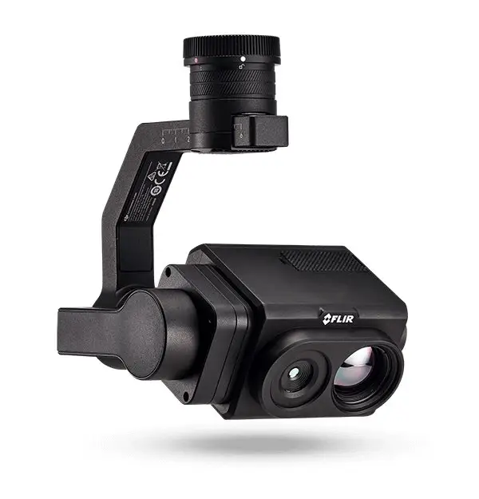
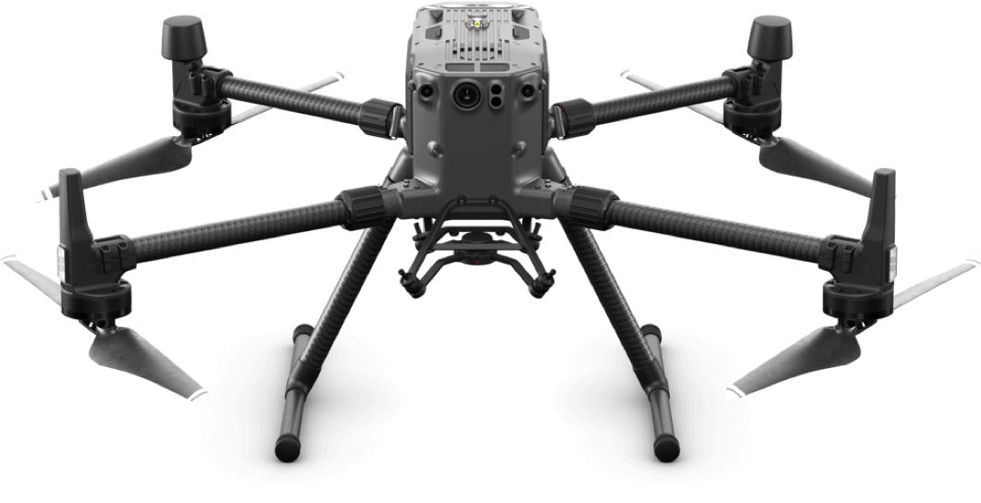
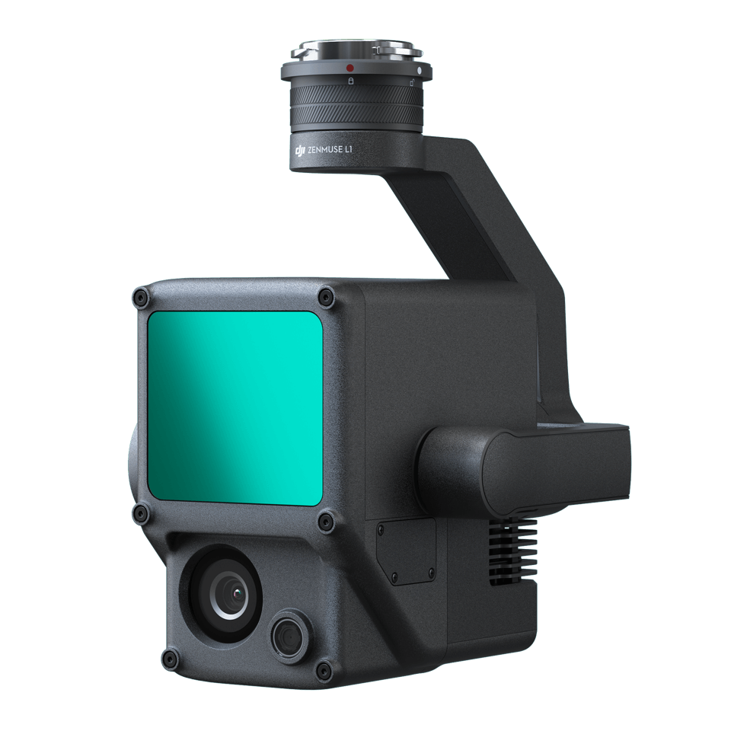
What equipment is available?
DJI Matrice 300 RTK
FLIR Vue TZ20-R
DJI Mavic 3E RTK (x2)
Zenmuse L1

Slide 5
LiDAR workflow
Typical range error 10 – 30 cm
Proprietary format, export to LAS through DJI Terra
1-device permanent license in RSGAL

Slide 6
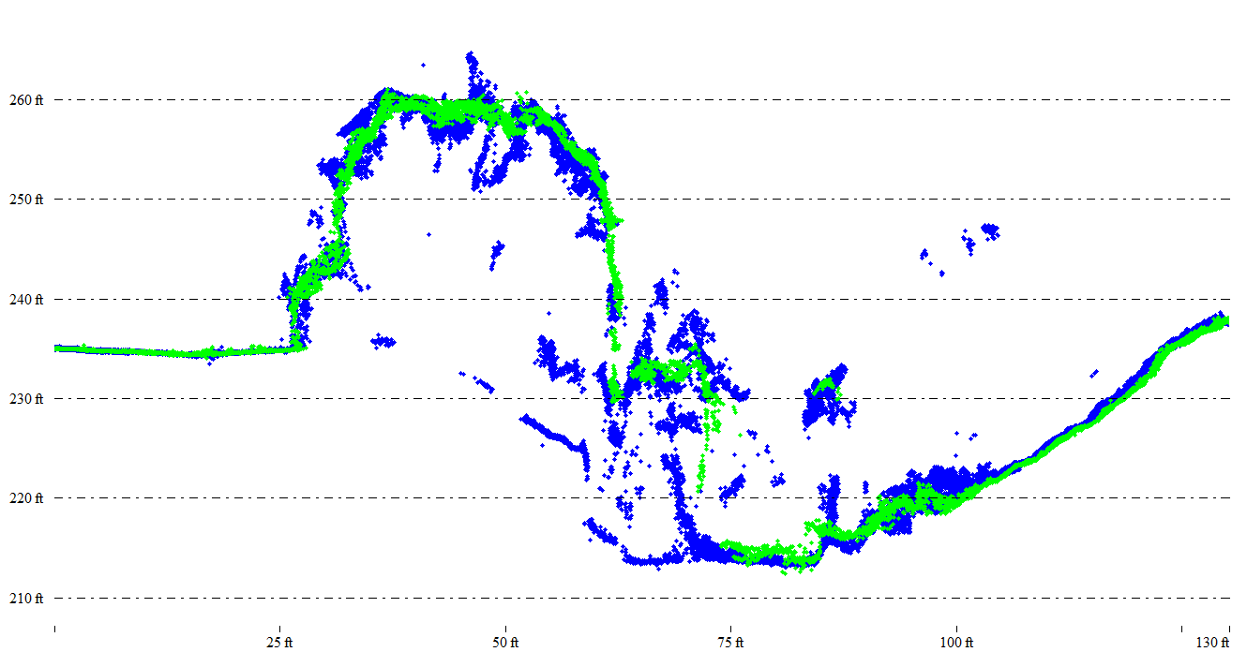
Photogrammetry Only
L1 Point Cloud
Source: Aerotas.com

Slide 7
Thermal workflow
Radiometric vs. Non-radiometric
Radiometric cameras still require calibration
Distance to target
Emissivity of target
Relative humidity
Reflected temperature
Measure three times to measure once

Slide 8
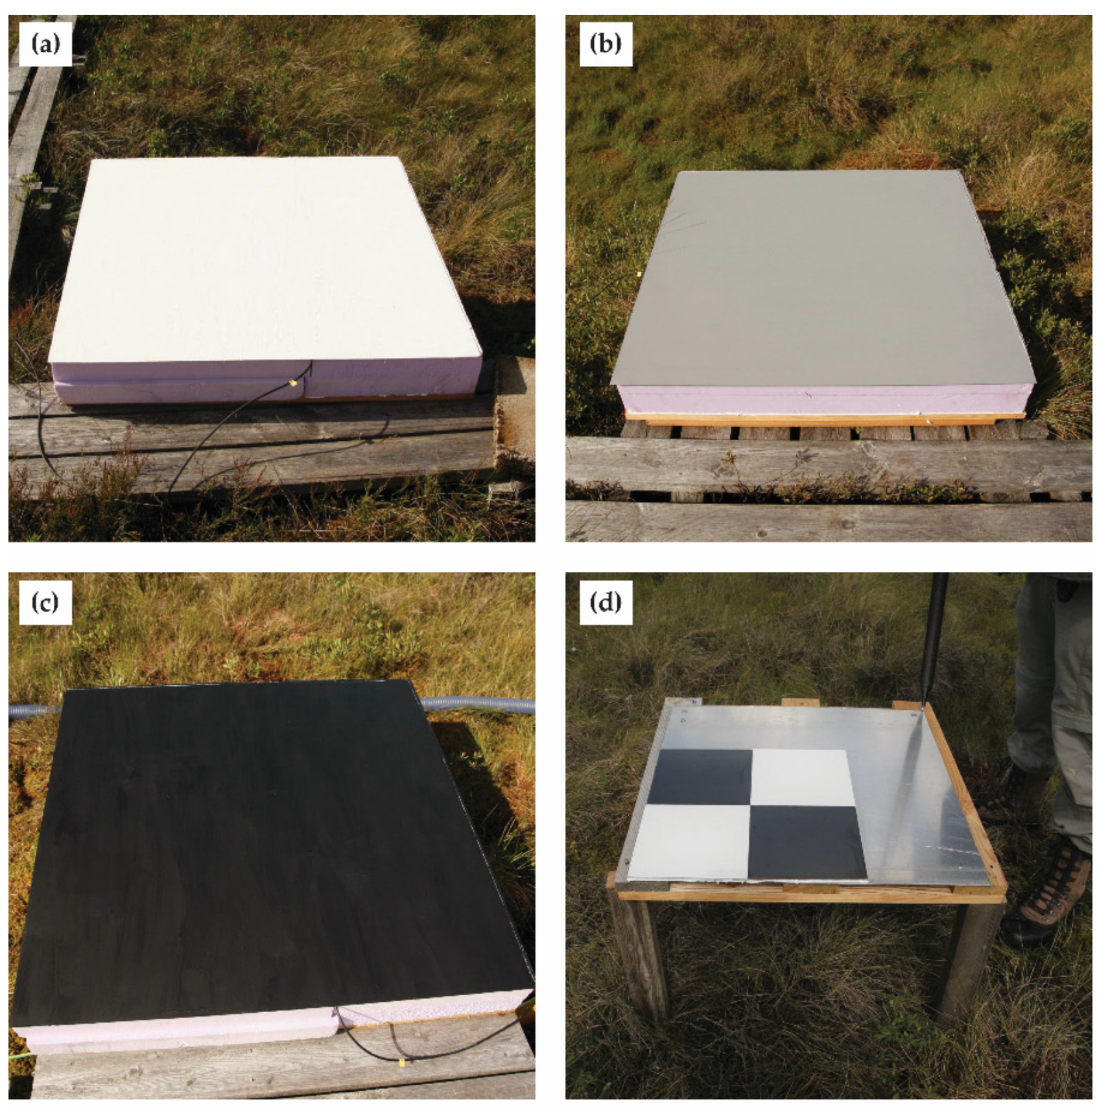
Kelly et al. (2019) Remote Sensing (11) 567

Slide 9
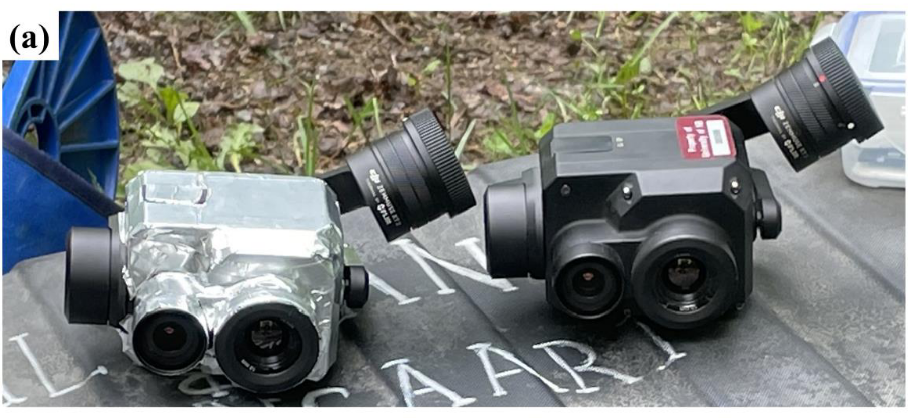
O’Sullivan and Kurylyk et al. (2022) Remote Sensing (14) 6356

Slide 10
Regulatory Requirements
Licensing
Insurance
Liability insurance mandatory, typically $10-$50 per flight
Airspace
No flying near airports, hospitals, stadiums
Land ownership
Not able to fly on federal land
FAA Remote Pilot Certificate (aka Part 107)

Slide 11
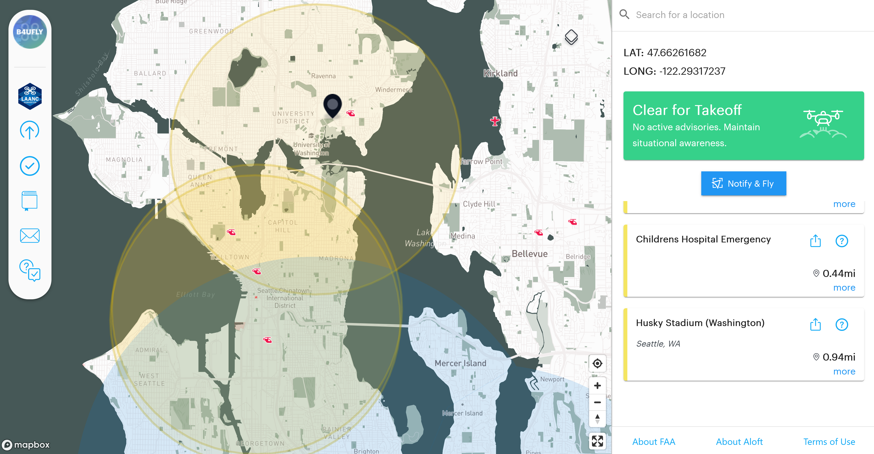

Slide 12
Notes:
As an example of how to purchase drone insurance, this is a recording of the Verifly app. As you can see, you simply select the location of your flight, make sure its in nonrestricted airspace, then enter your parameters, and that’s it.

Slide 13
Checking out equipment
First come, first served
Eligible for UW students, faculty, and staff
Submit a flight plan through the UW Geospatial Club website
Review safety, regulatory compliance
Show proof of license and insurance

Slide 14
Thank you!
Keenan Ganz
ganzk@uw.edu

